Slide 1
Decentralised Application Design Process
Source of some materials:
Xiwei Xu, Ingo Weber, and Mark Staples. Architecture for Blockchain Applications. Springer, 2019

Slide 2
Outline
Blockchain suitability evaluation
Application design process
Notes:
We’ll start with a framework to evaluate whether a given use case is suitable to be solved with a blockchain.
Then, if it is determined to be suitable, we will discuss how we can start designing the system while addressing some of suitability questions that need to be addressed during the design process.

Slide 3
Blockchain Suitability Evaluation

Slide 4
Use Blockchain Where It Makes Sense
Trustworthy & efficient ways to work together
Focus on gaps in multi-party interactions
Data integrity for information sharing
Transparency of data & decisions
Monopolies & unfair behaviour
Break information silos
Establish neutral ground for coordination
Don’t use blockchain where it doesn’t make sense
Does using blockchain make a system possible?
Or does it offer big benefits?
4 |
Notes:
Before we decided to build a software system using blockchain, we need to first determine whether it makes sense to use a blockchain to solve the problem.
We said that blockchains are good for new trustworthy or efficient ways of working together.
So our focus should be on gaps in multi-party interactions. Here, a party could refer to an individual or organisation.
Gaps could include data integrity issues, lack of transparency on what data were used and how we use them, and monopolistic behaviour leading to fairness issues.
We may also want to break information silos where information is scattered around.
Or you may just want to establish a neutral ground for coordination among a set of industry bodies.
We should not use blockchain where it doesn’t make sense, which is not uncommon. So we should ask questions like:
Does using blockchain make a system possible? – This is for a system that does not exist.
Or if the system already exists, does being in a blockchain will offer big benefits?

Slide 5
Evaluation Framework
+ Performance
+ Privacy
- Trust
Notes:
This is an evaluation framework from the textbook that illustrates the flow to evaluate the suitability of blockchain technology to solve a given problem.
There are 6 main questions to be answered, shown as white diamonds.
Some of the questions have follow-up questions as shown in grey diamonds.
We will discuss each of these questions in detail.
Then we have a decision on whether to use a blockchain, DLT, or conventional databases.
Many assumptions are leading to this framework. E.g., when it comes to DLT it’s considering ones like Hyperledger Fabric and R3 Corda. So it distinguishes a DLT from a blockchain-based on high performance, privacy, and low trust properties. However, this distinction is quite not there as both DLTs and blockchains have mixed characteristics.
Also, it was developed 4+ years ago. So there are some shortcomings in this framework when it comes to the latest technology.

Slide 6
Evaluation Framework (Cont.)
Is multi-party required?
Does the use case involve multiple parties?
Are they administratively decentralised?
E.g., Parties in supply chains, inter-bank payments, & trading
Is trusted authority required?
Does the trust depend on a party that controls/coordinates other parties?
E.g., a bank, central bank, exchange, & government
Can we decentralise trusted authority?
E.g., replace authority with an industry consortium
Notes:
Given a use case, the first question to ask is does the system need to serve multiple different parties?
Multi-parties are different legally distinct parties.
If there are multiple parties, we still need to determine whether they are administratively decentralized. E.g., multiple users or departments of the same business are quite administratively decentralised.
Such parties include members of the supply chain; banks involved in inter-bank payments; and investors (buyers and sellers), businesses, and trading service providers like exchanges, asset managers, and custody/record-keeping parties.
Here the multiple parties are at least two different banks, but may also include the account holders performing payment transfers between the banks. So, parties might be organisations or individuals.
The next question is about the need for a trusted authority to realize the use case.
This question is essentially asking whether the trust depends on a single party that controls/coordinates other parties. If so, we have centralisation of trust, which is not desirable. Also, such an authority is a single point of failure
E.g., a party like a bank or central bank that coordinates transactions between other parties is such a trusted authority.
Similarly, an exchange coordinates the interaction between the buyers and sellers. Another example of a centralised authority in the government that mediates certain interactions.
Now, if there is such a trusted authority, then a related sub-question would be, can that trusted authority be decentralised? If there is a monopoly, there is no real advantage of having a blockchain as the entire trust relies on that monopoly.
In situations where the trusted authority is a monopoly or oligopoly service provider, there is also the possibility of what economists call “rent-seeking” behaviour. Unreasonably limit access to the service and can reduce efficiency through excessive charges. An example of rent-seeking is when a company lobbies the government for loan subsidies, grants or tariff protection. These activities do not create any benefit for society but merely redistribute resources from the taxpayers to the company.
While the trusted authority may not be replaceable in many use cases, sometimes we can replace that authority with an industrial consortium where everyone has equal rights.
However, recently we are now seeing use cases that even a trusted authority may use a blockchain to get other benefits, such as programmability. Central bank digital currencies (CBDC) and registries maintained by stock exchanges about asset ownership are examples of systems using blockchains, even though it is under the control of a single trusted authority.

Slide 7
Evaluation Framework (Cont.)
Is operation centralised?
Does one party act on behalf of others?
E.g., NPP, Visa & Mastercard are joint ventures between banks
Can control be given back to parties?
Is immutability required?
Is there a need to keep track of historical changes?
E.g., finance industry, food safety, & ownership of collectibles
Notes:
The third question focuses on whether the operations within the use case are centralised, i.e., whether one party is acting on behalf of other parties.
E.g., the National Payment Platform (NPP), Visa, and Mastercard are joint ventures between banks established to facilitate payments.
Such parties are formed to make the operations easier. However, the centralised operation of the system leads to the administering party becoming a trusted authority, which may cause a single point of business failure.
Blockchain-based systems do not need a single system operator and can achieve better system reliability and availability when the administration is decentralised.
So the question is can we decentralise the operations of such a party to give the contract back to the parties?
Next, we are asking whether the use case requires data immutability.
If we need to keep track of historical data or changes to them, then we need immutability.
This is a common requirement in banking, finance, and insurance where data and changes to data need to be retained for 7 to 10 years. This may also apply to other domains like supply chains to track and trace where food is so that we can trace back a source of an outbreak and trace forward to issue alerts. Another use case is the collectible where provenance and change of hands are important to determine authenticity.
Immutability, when combined with digital signatures, also provides non-repudiation.
This is normally a good thing in supporting data integrity. However, it can cause problems if blockchain contains illegal content, or if a court orders content to be removed from the blockchain. It will be easier to support these requirements using conventional technologies.

Slide 8
Evaluation Framework (Cont.)
Is high performance required?
Is there a need for low latency, high throughput, high scalability, etc.?
Can big data be stored off-chain?
Is some representation of data (e.g., hash) on-chain enough?
Is transparency required?
Are other parties expected to see data?
Is it ok to store encrypted data?
Is it ok to reveal secondary data?
E.g., TX frequency, volume, parties involved
Notes:
The 5th question focuses on performance. As discussed so far blockchains are not the most performant and scalable compared to centralized technologies.
If there is a need for low latency, high throughput, high scalability, and storing large volumes of data, blockchain may not be the most suitable technology.
So, a question of interest is can we keep high volume or velocity data off-chain and somehow use a representation of that data on-chain?
Consortium and private blockchains with careful design and performance tuning have demonstrated better performance. Also, it is important to understand that some of the recent blockchain platforms have much higher performance and can be comparable with centralised technologies for certain application scenarios. Hence, we need to answer this question while considering the blockchain platform to be used to implement the use case.
The final question in the design process is whether data transparency is required or acceptable in the system.
This question is essentially asking whether it is okay for other parties to see data.
Very often customer relationships, pricing, or aggregate transaction volume are commercially-sensitive information. Volume might be inferred from transactions, even if the content is encoded or encrypted.
If it’s ok to have transparency on such data, we can use a blockchain.
Otherwise, we can think of ways to hide data such as encrypting data before storing them on a blockchain. Another option is to create a new address for each transaction, so we can benefit from pseudo-anonymity. However, this does not work in enterprise blockchains as parties are known.
However, storing encrypted data on-chain limits the type of computations that can be performed on-chain.
Encrypting data will make it difficult or impossible to use smart contracts with that data. If information needs to be processed by smart contracts, the information typically has to be decrypted. However, embedding keys within a smart contract would reveal the keys to all participants of the blockchain network, enabling anyone to decrypt data.
If storing encryption data is not desirable (e.g., they can eventually be decrypted someday) or going to limit on-chain computations, then we can think of using a DLT.
Ultimately, at the end of these six main questions, it should be clear to ask whether it’s better to use conventional databases, blockchains, or a DLT.

Slide 9
Suitability Evaluation Use Case – Identity Management
Individuals, organisations, devices, & assets are identified in many ways
E.g., passports, certificates, ABNs, serial numbers
Conventionally managed by a centralised trusted authority
Specify a set of user permissions & roles to limit access
Identities & permissions are read frequently, but updates are infrequent
Integrity of identities & assigned permissions is critical
Auditing mandates logging all system accesses
Complicated authorisation
Requirement for dynamic revocation of authorisations
Requirement for delegated authorisation
Notes:
Next, we are going to consider a couple of use cases from the textbook to see how we can apply the suitability evaluation framework. We start with an example from identity management.
Identity management (ID management) or identity and access management (IAM) is a framework of policies and technologies used to ensure that the right users have the appropriate access to a system.
We identify individuals, organisations, devices, and assets in many ways such as passports, certificates such as registration and marriage certificates. If it is a business, we can use an Australian business number (ABN). For a product, we may use a serial number.
Search forms of identities are issued and managed by centralised trusted authorities. For example, only a designated government institute can issue a passport.
Such an identity document or a card (either in physical or digital form), specifies a set of user permissions and rolls. Such as what countries you are allowed to travel to or what features of a system can be accessed.
Identities and associated permissions are read quite frequently, but they are rarely updated, e.g., whenever your travel, passport details are read but data gets updated only when you get a new passport or some material change is needed, e.g., age or name.
We need to ensure the authenticity of identities and permissions by protecting the integrity of their identity object, e.g., passports.
It should be possible to audit one’s actions on a system; therefore, all forms of system access should be extensively logged.
Identity management is not only bureaucratic but also a complicated process.
For example, we need to think about how can one revoke an identity. If you have a physical card like a driver’s license you can at least take that into custody. However, one can at least take a screenshot of the digital driver’s license. So, if one looks at the digital version, he/she may not know that the identity is revoked. Also, there can be a lag in revoking an identity, and that information is available to the identity verifier.
Today, identity management is centralised, e.g., logging in with Facebook and Google. We have already realised some of the privacy concerns around this approach. There is a growing demand to decentralise such identity management processes.

Slide 10
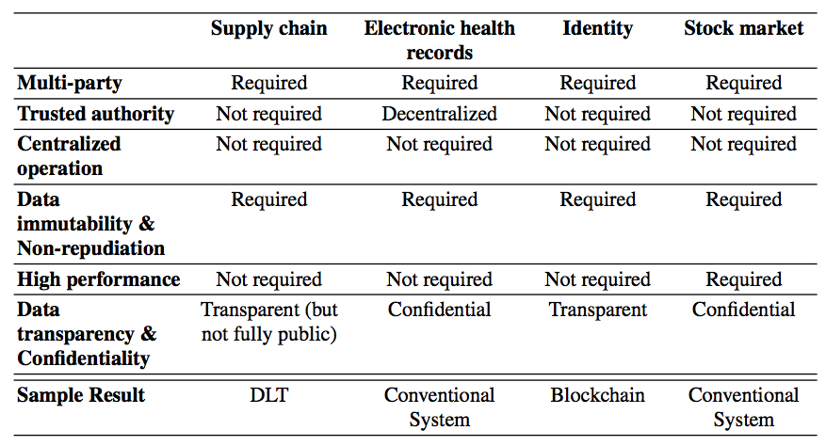



Identity Management (Cont.)
Blockchains allow identities, roles, & authorisation of users to be verified by decentralised parties
Remove centralised data & administration
Ensure integrity of identity data
Multiple records for different subsets of identity information
Privacy is critical
Personally Identifiable Information (PII) is kept off-chain or encrypted on-chain
Notes:
Let’s apply the six main questions from the blockchain suitability evaluation framework to identity management.
Identity management involves multiple parties, e.g., the identified party, the party that issued the identity, and the party that verify the identity.
What is the current approach of identity management involves a trusted authority, for many use cases it is not essential, or at least we can decentralise that authorities role.
While sometimes the same party is involved in issuing and verifying identity, it is not essential. For example, you can provide the identity in a form like a driver’s license that anybody can verify.
We need the integrity of the identity as well as all actions with that identity need to be tracked for auditing purposes.
While identities are read or verified quite often, they are not updated that frequently. Therefore, we don’t need high performance.
Identities are all about transparency because we need to know who can do what.
So, if you follow the evaluation framework, we will end with blocking as a suitable technology to implement identity management solutions. E.g., Uport, onename, and Hyperledger Indy are examples of black chain-based identity solutions.
So to summarise, blockchains allow identities, roles, and authorisations of users to be verified by decentralised parties. Sometimes, even the identities could be issued by decentralised panties.
Therefore, both the identity data and their administration are decentralised.
Blockchains integrity property ensures the integrity of user identities, roles, and authorisations.
We could even split the identity information into different parts. For example, we can keep the age, gender, and address of a party as separate identity documents. Then when you go to a put you only need to prove that you’re over 18.
Privacy is a critical requirement for IDMs, and so plaintext identity information for users is not normally stored directly on a blockchain. Instead, that is either kept off-chain or perhaps encrypted on-chain.
For any solution, a significant privacy concern for system designers must be the possibility of reidentification attacks that may allow identities to be inferred from meta-data or relationships stored on the blockchain.

Slide 11
Other Use Cases
Notes:
Let’s talk about the supply chain use case.
Supply chains are multi-party systems without a trusted authority.
A vertically integrated supply chain typically has a centralized operator. However, it is not very difficult to decentralize this role.
To be able to track and trace what happens on a supply chain, we need to record all the data in an immutable matter. If something goes wrong, it should be possible to even figure out who is responsible for what. So, we need non-repudiation as well.
High performance depends on how you look at the problem. If you want to track and trace every item that flows through the supply chain, then blockchain is not the best way to store that data. However, if we consider large batches or containers of items, then of course the volume of data may be trackable on a blockchain. While reasonably short latency is required at key points of the hand-over of goods, there is no requirement for extreme throughput or latency.
When it comes to transparency, we need to know how the items flow, but not necessarily information such as the price of items.
Particularly given the business confidentially need a decent ledger would probably be a better option to use a DLT over the blockchain.
Another example is stock markets that are quite related to blockchains given decentralized finance.
However, trading requires very high performance where the typical latency to buy and sell assets is usually in nanoseconds. Also, many buy and sell orders are processed concurrently.
In most jurisdictions, regulatory approval is required for the operation of stock market infrastructure, and regulatory approval may be required for the trading of specific stocks. In those contexts, the stock market is a naturally trusted authority.
There needs to be confidentiality in terms of price, volume, and parties buying and selling.
Therefore, high-frequency trading is better handled through databases.
However, as stock markets typically settle trades (i.e. exchange the stocks and payment) at a later time, blockchains are useful in the record-keeping of assets. E.g., NASDAQ offers its Linq blockchain ledger for the registration and settlement of private securities.
The last example is electronic health records management and sharing.
While it involves multiple parties, no central party dominating the operations or establishing trust, and there is a need for mutable record keeping, the biggest concern is the privacy of health data.
Healthcare service providers are decentralised trusted authorities. Each has access to patient data and the authority to make changes.
Operation is distributed across healthcare service providers
Health records cannot be inappropriately created or updated
Data transparency is the main issue - Patient privacy, is shared with patient consent, except in emergencies. Access to anonymised data for approved medical research
In addition to tight controls on read access, it is also important that health records cannot be inappropriately created or updated.
Also, accesses made to EHRs are often required to be logged for audit purposes.
Hence, such data is better managed via centralized technologies.

Slide 12
Design Process

Slide 13
Design Process
At every step systematically decide between alternative options
Notes:
Once you decide to use a blockchain for a given use case, we need to design the solution. During which we also need to address some of the questions raised during the suitability evaluation.
This figure outlines a design process where at every step, we need to systematically decide between alternative design options.
We first determine how the trust can be decentralised if it’s centralized.
Next, we focus on what mix of data and computations to be performed on-chain and off-chain.
Next, we need to pick a suitable blockchain framework.
Other related design choices include the configuration of that blockchain like block size and inter-block time.
Finally, we need to think about how to deploy and operationalise it. A related topic is governance which is covered in a later topic.

Slide 14
How to Decentralise?
How to decentralise administrative control?
Ok for some components/functions to be decentralised while others to remain centralised
Trusted authority may use a blockchain to get other benefits, e.g., programmability
E.g., CBDC & registries (stocks, land titles)
Centralized monopolies
Central parties with a competition between parties
Services provided jointly by a consortia
Full open service provision in a P2P system
Notes:
After evaluating the suitability of using blockchain, the next step is to decentralise the trusted authority if there is any.
While the trusted authority may not be replaceable in many use cases, sometimes we can replace that authority with an industrial consortium where everyone has equal rights.
There is a spectrum of options ranging from centralised monopolies, to central parties with competition between parties, to services provided jointly by a consortium, through to fully open service provision in a public peer-to-peer system. However, talking to most of the options on the right means significant changes to how a business operates.
It is possible to arrive at an acceptable solution where some components or functions are decentralised while others are centralised.
However, recently we are now seeing use cases that even a trusted authority may use a blockchain to get other benefits, such as programmability. Central bank digital currencies (CBDC) and registries maintained by stock exchanges about asset ownership are examples of systems using blockchains, even though it is under the control of a single trusted authority.

Slide 15
On-chain vs. Off-chain
On-chain
User interface
Cryptographic key management
IoT integration
Communications with external systems
Many kinds of data/computations are better stored/performed off-chain
Scalability reasons – “Big” data & CPU & memory intensive computations
Confidentiality reason – Personal & business confidential data
Dealing with legacy databases
Notes:
The next step is to decide what is on and off the blockchain depending on the characteristics of data and computation.
While blockchains provide several unique properties, the amount of computational power and data storage space available on a blockchain network remains limited.
The monetary cost of using public blockchains follows a different cost model than conventional software systems.
Regarding cost efficiency, performance, and flexibility, major design decisions in using a blockchain include choosing what data and computation should be placed on-chain and what should be kept off-chain.
Functionality such as user interfaces, cryptographic key management, IoT integration, and communications with other external systems is inherently off-chain.
When data are kept off-chain for privacy or other reason, it also affects the computations that can be done on-chain, as without rich data smart contracts cannot run complex business logic.

Slide 16
On-Chain & Off-Chain Trade-off Analysis
Encrypting data before storing on-chain
Increase confidentiality
Reduce performance, may reduce transparency or independent auditability
Storing only a hash of data on-chain & keeping contents off-chain
Improve confidentiality & performance
Partly undermine benefit of blockchains in providing distributed trust
Single point of failure reduces system availability & reliability
Using private blockchain instead of public blockchain
Allow greater control over admittance of processing nodes & transaction into system
Increase barriers to entry for participation, thus partly reduce some benefit of using blockchain
Notes:
Here are a few examples of on- and off-chain trade-off we may need to consider.

Slide 17
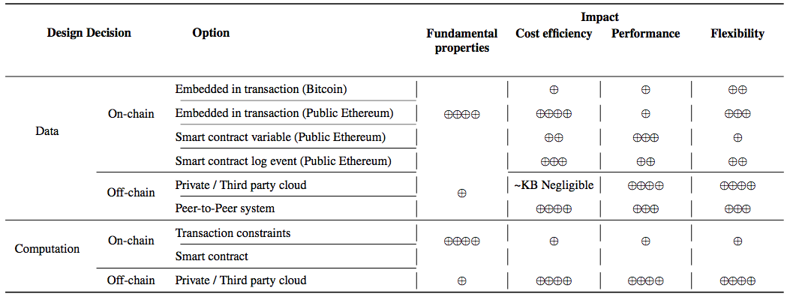
Design Decisions & Their Impact
Notes:
These kinds of overviews on design decision regarding on-chain and off-chain and their impact are useful in deciding what stays on- and off-chain.

Slide 18
Blockchain Selection
Select blockchain platform based on
Use case requirements
Characteristics of blockchain platform
Trade-off analysis
Select an existing blockchain platform
Consensus protocol & other decisions are fixed
Deploy a new blockchain instance while setting configuration options, e.g.,
Inter-block time is configurable
By configuration (private) or adjusting difficulty of mining (PoW)
Hyperledger Fabric supports pluggable consensus protocols
Notes:
The next step is to select and then configure the chosen blockchain. We are discussing them together as they are interrelated.
When choosing a blockchain platform we should consider aspects like:
Use case requirements – Most of these aspects are covered in the evaluation framework work, e.g., performance, privacy, and trust decentralisation.
Characteristics of blockchain platform like transaction cost, inter-block time, transaction throughput, time to finality, power consumption, no of nodes, etc.
We sometimes distinguish between a platform and a framework. A platform is an instance of blockchain software, e.g., Ethereum. Whereas blockchain software is referred to as a framework, e.g., Hyperledger Fabric (HLF).
What trade-offs we are willing to make based on trade-off analysis?
For use cases like publicly accessible tokens, we better use a public platform. However, there was a tendency to introduce a new blockchain with a new application. However, this trend has changed and now applications are released on established platforms, and they may later move to their platform.
Typically, once you chose an existing blockchain platform, consensus protocol and other decisions like transaction fees and performance are fixed.
However, if you decide to deploy an existing framework (including Ethereum) you can set various configuration options, e.g.,
Inter-block time is configurable just by configuration in private blockchains (e.g., in HLF you can change the default inter-block time of 2 sec) or adjust the difficulty of mining (e.g., PoW).
HLF also supports pluggable implementations of various consensus protocols. The number of operations is limited (almost none) in the latest releases as operations with security, performance, and availability issues have been churned out.

Slide 19
Deployment & Operation
Deployment impacts quality attributes
On-premises hosting
Decentralised, high-availability
High cost & administrative burden
Cloud hosting or BaaS (Blockchain-as-a-Service)
Low cost & administrative burden
Centralisation & relatively low availability
Operation challenges
Blockchains are harder to modify/update than conventional systems
Wasn’t immutability a key property in enhancing trust?
Updating software can be physically & administratively difficult to coordinate
Governance
Process of making & enforcing decisions on platform’s operations
Notes:
The last step is deployment and operation.
How you decide to deploy a blockchain platform impacts quality attributes.
On-premises hosting by multiple parties leads to better decentralisation and enhance high availability. However, this comes at a high cost of hardware and networking, as well as a high administrative burden where each site is expected to manage its instance independently of others. Managing security is a bigger challenge and parties may not have sufficient expertise.
A more popular option for enterprise applications is cloud hosting or Blockchain-as-a-Service (BaaS). Like other cloud-based services this results and low cost and administration burden. However, reliance on a cloud provider means centralisation and relatively low availability (it may be possible to deploy the network across different availability zones of the cloud provider). Compared to individual parties managing security, cloud providers are better equipped to manage security as their scale of operations enables them to recruit experts.
This option is also used to host some public blockchain nodes, e.g., on AWS you can readily deploy an Ethereum node and connect it to a public Ethereum.
Operating a blockchain is challenging compared to conventional information systems.
Blockchains and smart contracts are harder to modify/update than conventional systems as changes need to be pushed to multiple nodes administrated by different parties. Hence, changes may not be applied across the entire system at the same time.
Alternatively, by design blockchains were not supposed to be updated as immutability is a key property that enhances trust. E.g., in smart contracts to regulate interactions between mutually-untrusting parties, trust is derived partly from the fact that the code cannot be changed easily.
Updating software can be physically and administratively difficult to coordinate. E.g., typically in blockchains, we update the software and after a certain block number only the updates take effect. The idea is by that block number majority of the nodes will be running the updated code.
Governance is the process of making and enforcing decisions on the platform’s operations.
In a multi-party system with no single owner, managing these changes is more like diplomacy than traditional risk management or conventional product management. Governance is essential to minimise conflicts, update smart contracts, and keep the system running.
Governance also answers questions like who pays for a decentralised system and who chooses policy (including privacy).
Lessons may be drawn from governance in open-source software, which faces similar development challenges.

